Slide 1
COLLECTIONS

Slide 2
Why Collections ?
Arrays have some limitations , For example, you need to specify the array’s size while creating the array. If at execution time, you want to modify it that means if you want to increase or decrease the size of an array, then you need to do it manually by creating a new array or by using the Array class’s Resize method, which internally creates a new array and copies the existing array element into the new array.
Collections is basically a dynamic arrays

Slide 3
What are Collections
Collection is a group of records that can be treated as one logical unit.
The Collections in C# are a set of predefined classes that are present in the System.Collections namespace that provides greater capabilities and functionalities than the traditional arrays. The collections in C# are reusable, more powerful, and more efficient and most importantly they have been designed and tested to ensure quality and performance. That means the collections in C# have the capability of storing multiple values but with the following features.
Size can be increased dynamically.
We can insert an element into the middle of a collection.
It also provides the facility to remove or delete elements from the middle of a collection. and most importantly they have been designed and tested to ensure quality and performance.

Slide 4
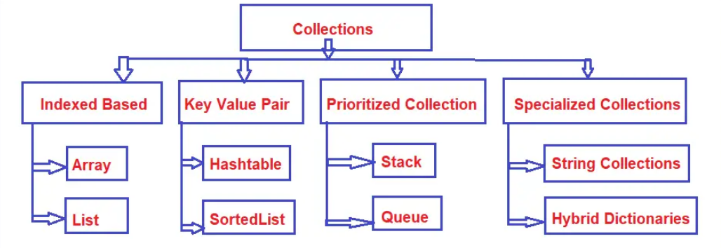
Categories of Collections

Slide 5

Indexed Base Collections
when we add any elements to .NET Collections like Array, List, or ArrayList, it maintains its own internal index number. This internal index number is auto-generated by the framework and using this index number we can identify the records.
Key-Value Pair Collections
We generally use some kind of keys to identify the records and there we use the Key-Value Pair collections like Hashtable, Dictionary, and SortedList . So, basically, if we fetch the records based on a key.
Prioritized Collections
The Prioritized Collections help you to access the elements in a particular sequence. The Stack and Queue collections belong to the Prioritized Collections category. If you want First in First Out (FIFO) access to the elements of a collection, then you need to use Queue collection. On the other hand, if you want Last in First Out (LIFO) access to the elements of a collection, then you need to use the Stack collection
Specialized Collections:
The Specialized Collections are specifically designed for a specific purpose. For example, a Hybrid Dictionary starts as a list and then becomes a hashtable.

Slide 6
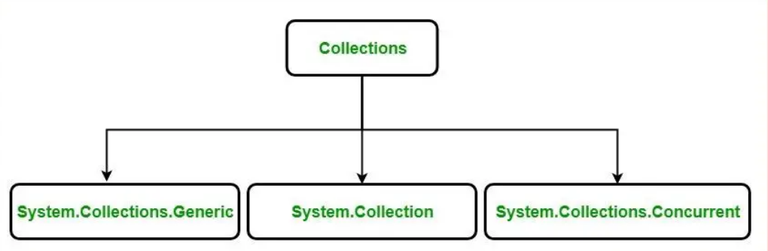
Types of Collections

